Slide 1
The Establishment of the Early Microbiome in Neonates: Determinants, Risks, & Therapeutics
Camilia R. Martin, MD MS
Assistant Professor of Pediatrics, Harvard Medical School
Associate Director, NICU, Department of Neonatology
Director for Cross-Disciplinary Research Partnerships,
Division of Translational Research
Beth Israel Deaconess Medical Center, Boston MA

Slide 2
Talking Points
Influences of the early establishment of the microbiome:
Maternal-Fetal environment
Ex-Utero determinants
Medical consequences of an altered microbiome
Strategies to protect and restore microbial diversity

Slide 3
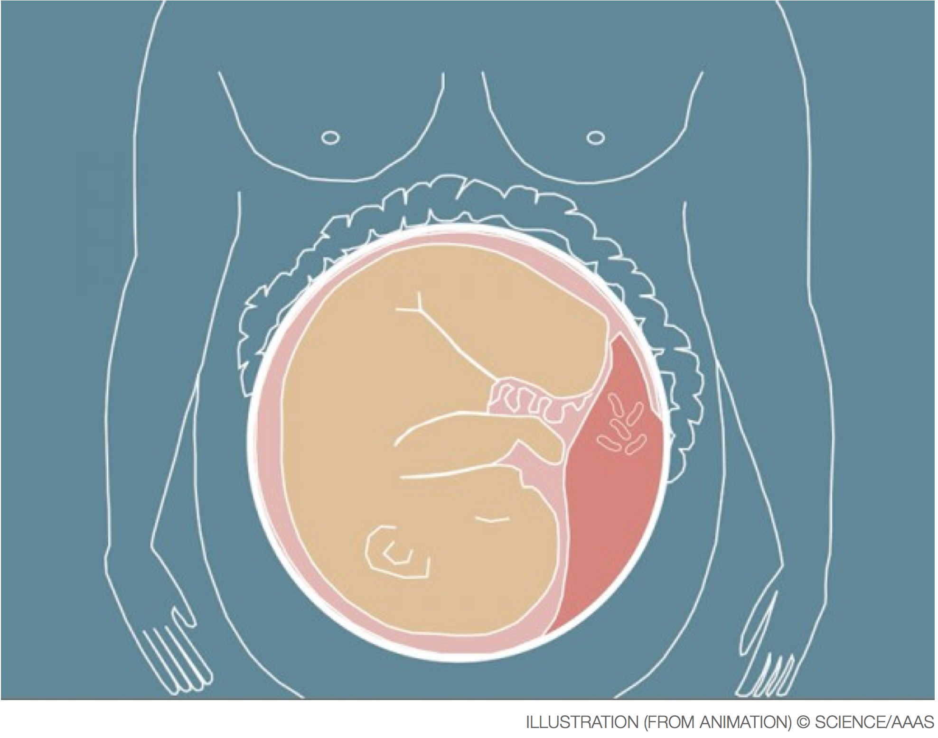
Maternal-Fetal Microbiome
Recent microbiome studies have challenged the dogma that the the Maternal-Fetal unit is sterile.
Placenta harbors a unique microbiome
(Aagaard K et al, Sci Transl Med. 2014)
Analysis of the first meconium reveal microorganisms
(Ardissone et al., Plos one 2014)
Analysis of tracheal aspirates after intubation at birth reveal microorganisms (Lohmann et al., Pediatric Research 2014)

Slide 4
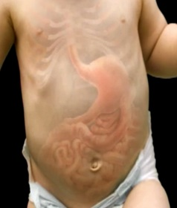
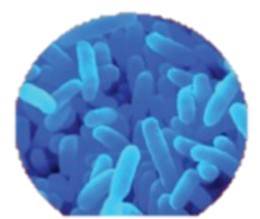
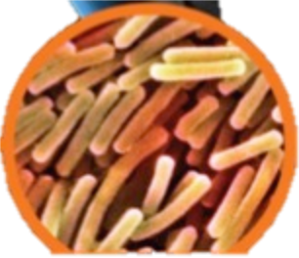
Colonization Patterns in the Newborn
Commensal Bacteria
Pathogenic Bacteria
Exposure | Bifidobacterium, Lactobacillus | Enterococci, Clostridium, Coliforms
Delivery Mode | Vaginal | Cesarean Section
Diet | Breast Milk | Formula
Hospitalization |  | ✔
Medications
Antibiotics H2 Blockers |  | ✔ ✔
Prematurity |  | ✔

Slide 5
Intestinal Tract: The Largest Immune Organ (70% of the Immune System) & Defense Barrier
Maintain integrity of mucosal barrier
Regulate appropriate bacterial colonization
Activate intestinal immune defenses
Modulate intestinal inflammation
Balance between appropriate tolerance & inflammatory attack
Non-specific intestinal barrier defenses
Epithelial cell layer
Gut-associated lymphoid tissue (GALT)
From Magalhaes JG, Tattoli I, Girardin SE. The intestinal epithelial barrier: how to distinguish between the microbial flora and pathogens. Semin Immunol. Apr 2007;19(2):106-115.

Slide 6
Necrotizing Enterocolitis:
Reduced diversity, increased proteobacteria
Microbiome is altered in ALL preterm infants!
Wang et al. ISME J, 2009

Slide 7
Necrotizing Enterocolitis
Commensal Bacteria
Pathogenic Bacteria
Chronic Lung Disease
Altered Immune Ontogeny
Dysregulated Inflammation
Impaired Organogenesis
Sepsis

Slide 8
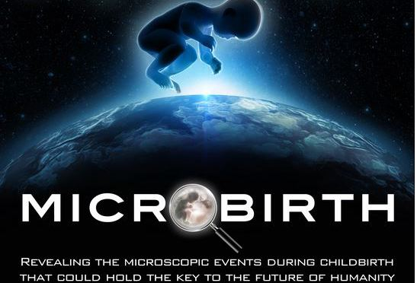
Birth Practices in Modern Society are Changing the Course of Human Disease
Autism
Celiac Disease
Type I Diabetes
Asthma
Obesity
http://microbirth.com/
http://biomeonboardawareness.com/microbirth-every-parent-needs-to-view/

Slide 9
Protect & Restore Diversity
Protect
Understand how current medical practices alter the microbiome
Re-evaluate medical practices that alter the microbiome
Restore
Probiotics
Restore natural colonization

Slide 10
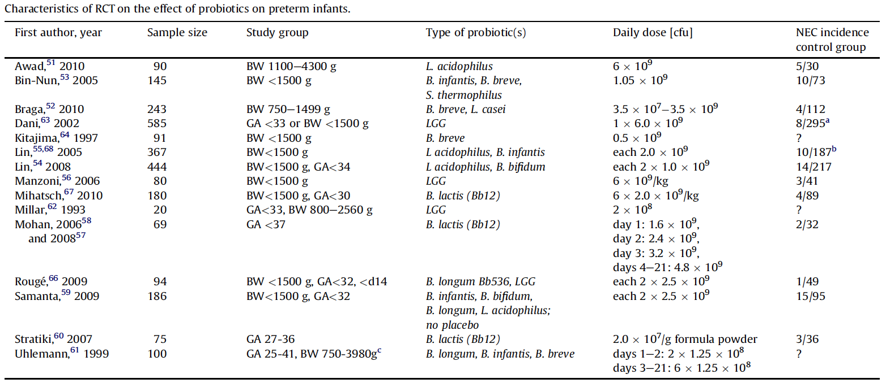
Probiotics
Diff Power
Diff entry criteria
Diff probiotics cocktails
Different doses

Slide 11
Probiotics
CDC, FDA, and the Connecticut Departments of Public Health and Consumer Protection, are investigating a fatal case of GI mucormycosis in a premature infant of 29 weeks gestation following the use of a probiotic supplement

Slide 12
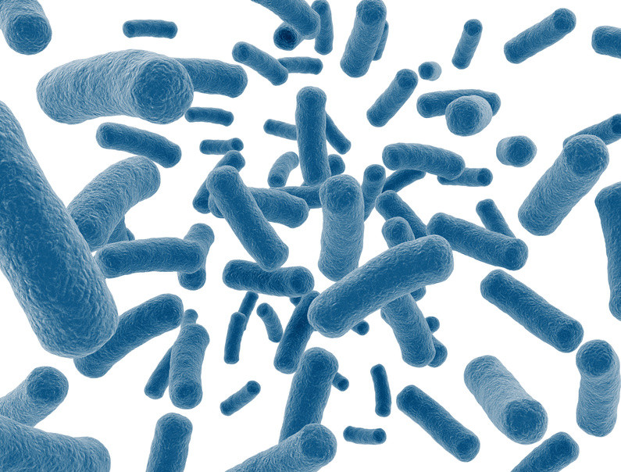
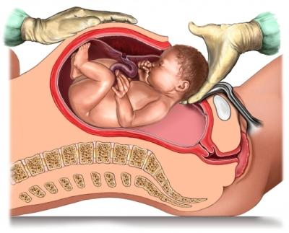
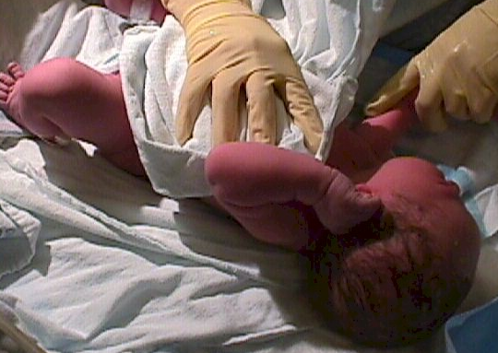
Restore the Natural Microbiome
www.brooksidepress.org
Dr. Maria Gloria Dominguez-Bello, associate professor in the Human Microbiome Program at the NYU School of Medicine
http://commonhealth.wbur.org/2014/06/birth-canal-bacteria-c-section

Slide 13
Determinants, Risks, & Therapeutics
Determinants
Maternal-Fetal microbiome, diet, environment, medications
Additional questions to pursue: quantitative vs. qualitative, epithelial host interaction, precise metagenomic/metabolomic effects
Risks
Altered microbiome and increased risk of disease
Impaired immunity, impaired defenses
Therapeutics
Protect and restore

